Slide 1

The Plagues of Conformity on a Modern American Society
AP Seminar Performance Task 2 Individual Multimedia Presentation

Slide 2

Is there benefit to conformity in modern society and behavior?

Slide 3
Conformity
/kənˈfôrmədē/
Noun
Behavior in accordance with socially accepted conventions and standards.

Slide 4
Historical Context
Traditional views stemming from the 1950s, especially that of family values and peer influence.
Influence of internet culture and niche groups, heightened by the global pandemic.
Conflicting views stemming from previous points.

Slide 5
What research strategies were utilized?
Cultural Impact in Fashion and Economy
Impact in Democracy
Societal Impact in Intergenerational Relations

Slide 6
Cultural Impact in Fashion and Economy
“Ultra-Fast” Fashion
BooHoo’s testing of products
The Judging of the Audience
Customer Stresses

Slide 7
The “Generational Gap” and Generational Relations
UNC Dept. Psych. Study on Adolescents
Generational Gap – Difference in social norms between generations of people.

Slide 8
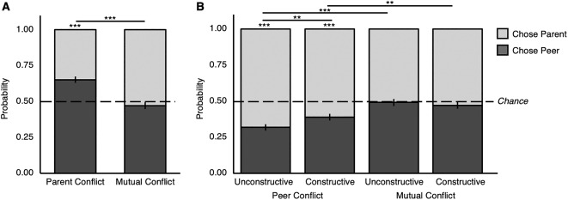
Natural Response to Resisting Parental Attitudes that Conflict with Personal

Slide 9

Generational Relations and Cultural Assimilation – The Namesake
Child grew with a fondness for British and American life.
Forced into cultural practices by Indian family.
Decides for name change based on author’s history.
Forcing of cultural identity leads to tension.

Slide 10
Generational Relations and Politics – “Gen X” vs “Gen Y”
Gen X:
Great Political Turmoil and Corruption
Centrist Views – Individual liberty with Patriotism and Imperialism
Gen Y:
Anti – Government, Race Relations Support
A Shift in Status Quo

Slide 11
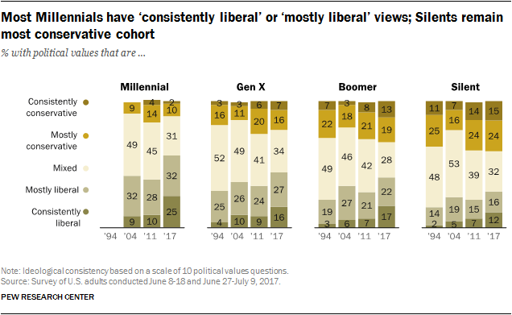
A Change in Politics Throughout the Ages

Slide 12
Mutual Aid in Political History – De La Democratie en Amerique.
Associations formed based upon groups a person belongs to.
Valued based upon education, religion, morals, etc.
Society not becoming functional if voluntary aid is not acceptable.
Greater power in several factions rather than one major leading political party (Federalist No. 10)

Slide 13
Conclusion
Attempting to force conformity is harmful in modern society.
Mutual benefit in smaller groups, such as between diverse factions, is more effective.

